Slide 1
Anaerobic digestion development Deciduous woodchips
Dissolved oxygen
Inflow
Inside bioreactor

Slide 2
NO3 removal efficiency Deciduous woodchips

Slide 3
NO3-N removal (cumulative curves)

Slide 4
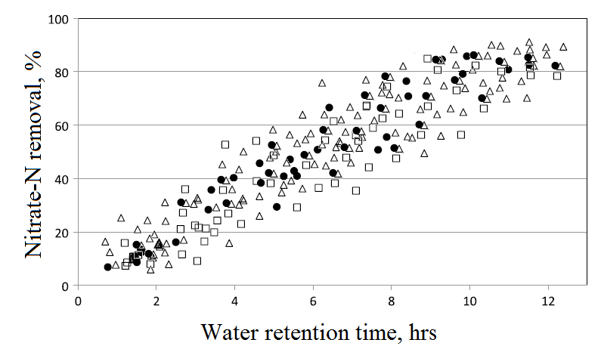
Nitrate removal in woodchip bioreactors

Slide 5
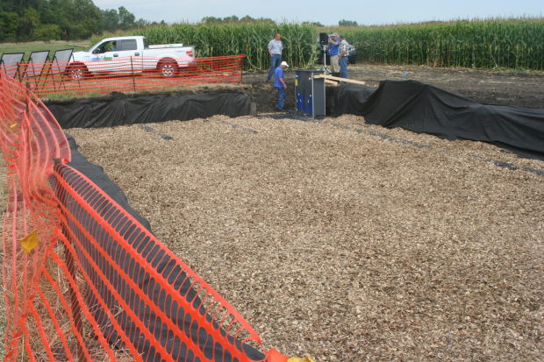
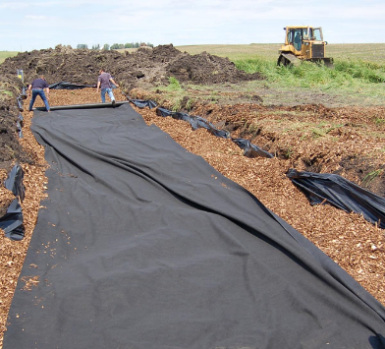
Woodchip bioreactors
Photo courtesy Agri Drain Corp.
Denitrifying bacteria use the carbon in the woodchips as their food and use the nitrate as part of their respiration process!

Slide 6
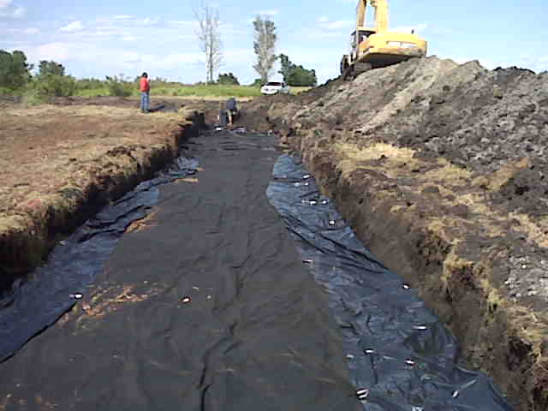
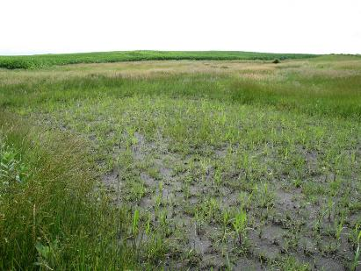
Bioreactor installation
Photo courtesy : Iowa State University, USA

Slide 7
Woodchip bioreactors main characteristics and estimated cost
Dimensions: L: 5-30 m
W: 1-7 m
H: 1.1-1.3 m
Size of wood material: 0.5-2.5 cm
Lifetime: 15 years
Drainage area: 12-40 ha
Negative side effects: tea-colored water
Costs: 7 000-10 000 Eur

